Slide 1
ESCP 2017 Snapshot Audit: Left Side, Sigmoid & Rectal Resections
Your name
on behalf of the 2017 ESCP Collaborating Group
European Society of Coloproctology | www.escp.eu.com | @escp_tweets | @ESCP_studies | #ESCP2017audit
Notes:
Please feel free to present your data and the template slides to your unit. We are also keen for collaborators to present at regional and national conferences, however to avoid duplication please contact us at <escp@contacts.bham.ac.uk> first to avoid any duplication in abstract submissions. To help us keep track of local and national presentations, we would be very grateful if you please complete our brief feedback survey once you have presented the data/slides: https://bistc.redcap.bham.ac.uk/surveys/?s=CCPP74RTH8. We would be very interested in your feedback!

Slide 2
2015 Right Hemicolectomy Audit
First ESCP audit
3,208 patients
284 centres across 38 countries
Laparoscopy rate 54.6%
9.6% conversion rate
Overall leak rate 8.1%
30-day mortality 3.2%
Three papers published in Colorectal Disease
European Society of Coloproctology | www.escp.eu.com | @escp_tweets | @ESCP_studies | #ESCP2017audit
Notes:
Key points:
The ESCP’s first international snapshot audit was conducted in 2015
This included 3208 patient undergoing right colectomy
The overall leak rate was 8.1%
Three manuscripts have been written from the dataset and published in colorectal disease & 2 further papers are currently under review

Slide 3
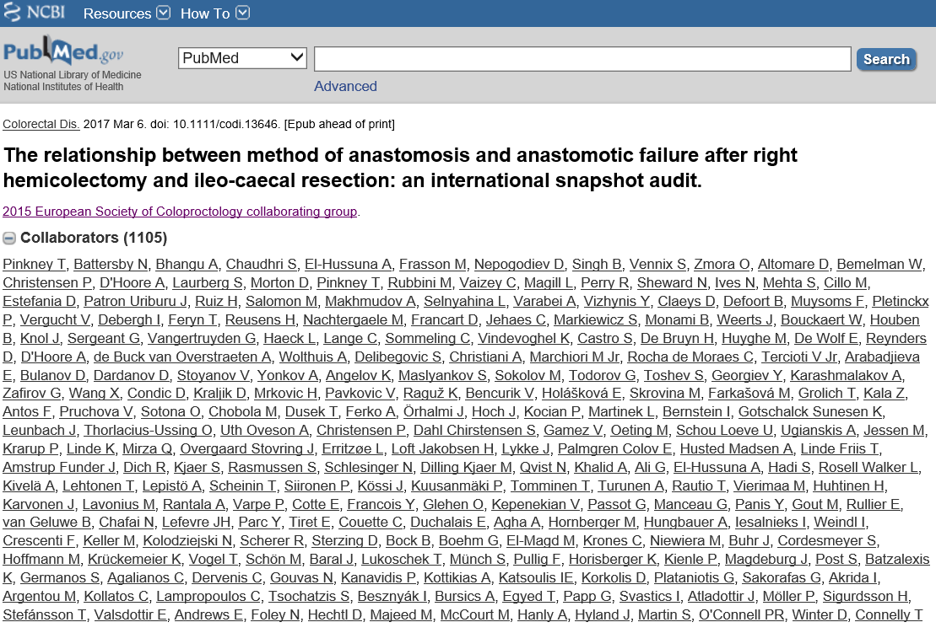
ESCP collaborative authorship model
Leverages power of an international network to rapidly collect large volume of data
Single corporate author
‘ESCP Collaborating Group’
All collaborators listed as co-authors on PubMed
European Society of Coloproctology | www.escp.eu.com | @escp_tweets | @ESCP_studies | #ESCP2017audit
Notes:
Key points:
The ESCP work under a single corporate authorship model
This means that all contributing collaborators are searchable as PubMed citable coauthors for all resulting publications

Slide 4
2017 audit methodology
Prospective, multicentre international audit.
Any colorectal unit in the world eligible to participate.
8-week patient inclusion window in early/mid 2017.
All patients undergoing left sided colonic or rectal resection captured (elective/emergency, malignancy/benign disease).
30-day follow-up.
Main audit outcome:
30-day overall anastomotic leak rate defined as proven anastomotic leak and/or intra-abdominal/pelvic collection.
European Society of Coloproctology | www.escp.eu.com | @escp_tweets | @ESCP_studies | #ESCP2017audit
Notes:
Key points:
The 2017 ESCP Snapshot audit was a prospective and multicentre study including any unit in the world that undertakes elective and/or emergency colorectal resection
Consecutive eligible patients were included during a 8-week patient inclusion window
Any left sided colorectal resections (i.e. with a resection margin beyond the splenic flexure) were eligible.
Stoma closure, panproctocolectomy, wedge resections or multiple segmental resections were all excluded.
The primary outcome measure was the overall anastomotic leak rate at 30 postoperative days – a composite of ’proven’ anastomotic leak or intraabdominal or pelvic collection

Slide 5
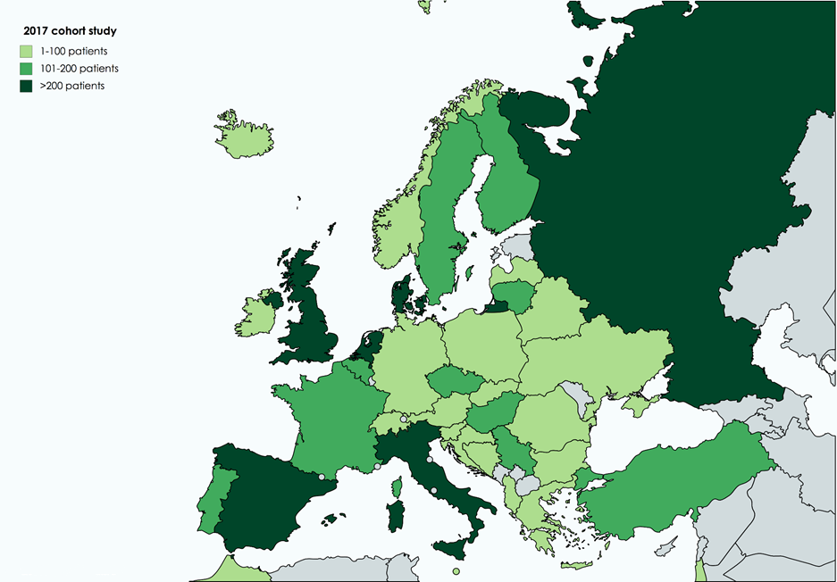
Participation in 2017 audit
5641 patients
335 centres
49 countries – of which
15 outside of Europe
European Society of Coloproctology | www.escp.eu.com | @escp_tweets | @ESCP_studies | #ESCP2017audit
Notes:
Key points:
The 2017 ESCP audit was truly international including 49 countries, 15 of which were outside of Europe
5641 patients in 335 centres were included in total

Slide 6
Patient demographics
 |  | International | Local
Age | Mean | 65.3 years
Sex | Female | 42.4%
 | Male | 57.6%
ASA | Grade I-II* | 64.7%
 | Grade III-V | 35.3%
Indication | Malignancy | 74.1%
 | Diverticular disease | 14.3%
 | Other | 11.6%
Urgency | Elective | 79.5%
 | Expedited | 10.0%
 | Emergency | 10.5%
*Including 43 cases whose ASA was missing
European Society of Coloproctology | www.escp.eu.com | @escp_tweets | @ESCP_studies
Notes:
Key points:
PLEASE INSERT YOUR LOCAL DATA POINTS TO COMPARE TO THE INTERNATIONAL DATASET. THIS HAS BEEN EMAILED OUT TO THE EMAIL ADDRESSES FOR THE SITE INVESTIGATORS AS REGISTERED ON REDCAP
Overall the mean age of the cohort was 65.3 years, with a roughly 60:40 split male to female
A majority of patients were operated for cancer (74.1%)
Two thirds of included surgeries were planned elective procedures (79.5%)

Slide 7
Operative details
 |  | International | Local
Surgical approach | Open | 39.5%
 | Laparoscopic | 47.7%
 | Laparoscopic converted | 8.8%
 | Robotic | 3.6%
 | Robotic converted | 0.4%
Anastomosis | Handsewn | 10.8%
 | Stapled | 64.5%
 | None- Hartmanns | 15.9%
 | None- Intersphincteric APR | 2.0%
 | None- Extra-levator APR | 2.3%
 | None- Standard APR | 4.5%
Anastomotic configuration | End-to-end | 75.2%
 | Side-to-side | 8.9%
 | Side-to-end | 15.9%
Euopean Society of Coloproctology | www.escp.eu.com | @escp_tweets | @ESCP_studies
Notes:
Key points:
PLEASE INSERT YOUR LOCAL DATA POINTS TO COMPARE TO THE INTERNATIONAL DATASET. THIS HAS BEEN EMAILED OUT TO THE EMAIL ADDRESSES FOR THE SITE INVESTIGATORS AS REGISTERED ON REDCAP
Overall the minimally invasive (laparoscopic or robotic) attempted rate was 60.5%, with a conversion rate of 9.2%
64.5% had a stapler anastomotic, 10.8% a handsewn anastomosis and 24.7% had an end colostomy (APR or Hartmann’s procedure)
In those patients who had an anastomosis, the most common anastomotic configuration was end-to-end (75.2%)

Slide 8
Patient outcomes
 |  | International | Local
Overall anastomotic leaks* |  | 8.6%
‘Proven’ anastomotic leaks |  | 7.3%
Complications (Clavien-Dindo) | None | 61.7%
 | CD grade I-II | 24.4%
 | CD grade III-V | 13.9%
Re-operation rate |  | 8.8%
Re-admission rate |  | 6.7%
Mortality rate |  | 2.1%
Length of stay | Mean | 9.4 days
*main outcome measure for the 2017 audit
European Society of Coloproctology | www.escp.eu.com | @escp_tweets | @ESCP_studies | #ESCP2017audit
Notes:
Key points:
PLEASE INSERT YOUR LOCAL DATA POINTS TO COMPARE TO THE INTERNATIONAL DATASET. THIS HAS BEEN EMAILED OUT TO THE EMAIL ADDRESSES FOR THE SITE INVESTIGATORS AS REGISTERED ON REDCAP
The overall anastomotic leak rate was 8.6% (7.3% ‘proven’ anastomotic leak)
The overall complication rate 38.3%, of which 13.9% were Clavien-Dindo grade 3 to 5
The mortality rate at 30 days postoperatively was 2.1%

Slide 9
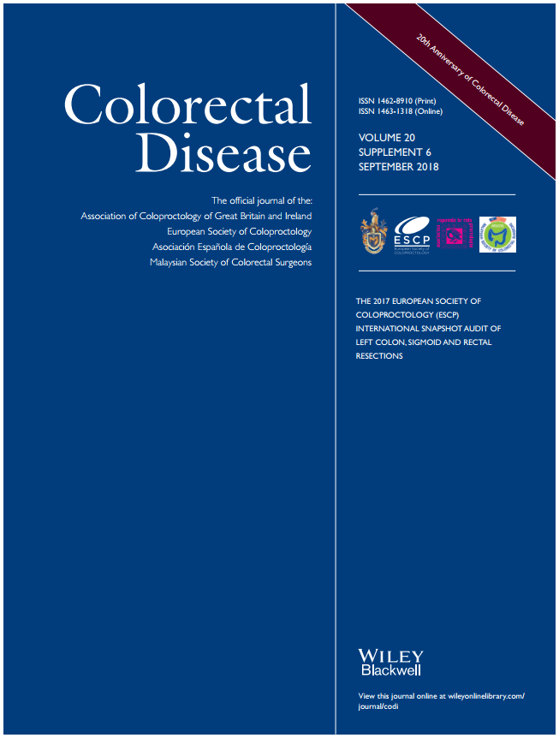
Colorectal Disease special edition
Notes:
Key points:
- As the database as included so many different operations and indications, five pre-defined subgroup analyses were conducted using the data
Five papers were published in a special edition of Colorectal Disease, released in parallel to the 2018 ESCP 13th Scientific and Annual Meeting
All collaborators are PubMed indexed and listed in the journal articles – many thanks in contributing your patients’ data

Slide 10
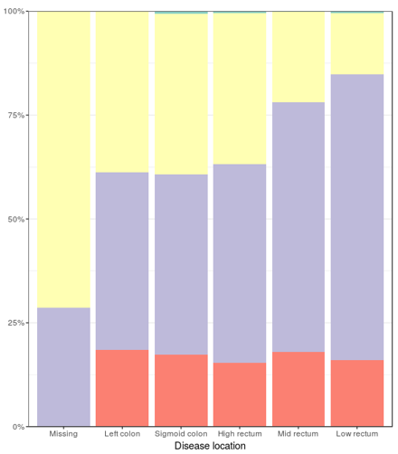
Bowel prep (n=3,676)
Question: Are oral antibiotics combined with mechanical bowel prep (MBP+ABx) associated with a reduced risk of anastomotic leak in elective left sided colorectal resection?
Patients: Elective left sided colonic or rectal resection with primary anastomosis
Main outcome: Overall leak rate.
Findings: The overall leak rate was 8.5%. In adjusted analyses, MBP+ABx halved the odds of leak compared to no bowel prep, but only 17% of patients received MBP+Abx in this cohort.
European Society of Coloproctology | www.escp.eu.com | @escp_tweets | @ESCP_studies | #ESCP2017audit
Notes:
Full details are available in the published Colorectal Disease special edition, available at: https://onlinelibrary.wiley.com/loi/14631318

Slide 11
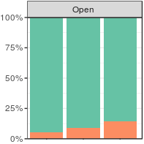
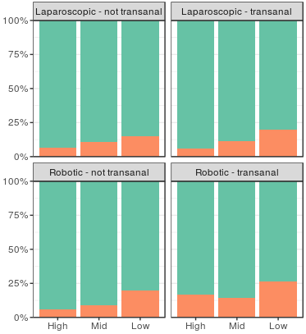
Transanal TME (n=2,579)
Question: How are patients selected for transanal versus non-transanal total mesorectal excision (TME) for rectal cancer, and what are the differences in early postoperative outcomes?
Patients: Elective TME for malignancy.
Main outcome: Overall leak rate.
Findings: The overall leak rate was 9.0%. One in five patients underwent a taTME approach. Leak and positive resection margin rates following taTME are equivalent to non-transanal procedures.
European Society of Coloproctology | www.escp.eu.com | @escp_tweets | @ESCP_studies | #ESCP2017audit
Notes:
Full details are available in the published Colorectal Disease special edition, available at: https://onlinelibrary.wiley.com/loi/14631318

Slide 12
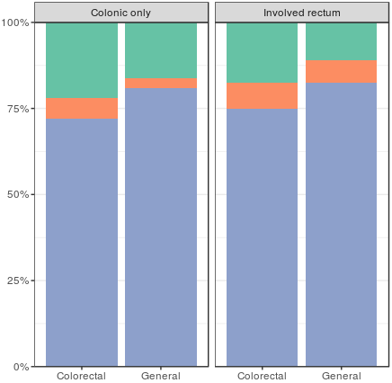
Emergency surgery (n=591)
Question: Is there a difference in complication rates with end stoma versus anastomosis following emergency left sided colorectal resection?
Patients: Emergency left sided colorectal resection.
Main outcome: 30-day Clavien-Dindo grade 3-5 complications.
Findings: Anastomosis is performed in up to one in five patients. In these highly selected patients, our data suggests it is safe practice. A defunctioning stoma does not reduce risk of leak but may reduce morbidity if a leak does occur.
European Society of Coloproctology | www.escp.eu.com | @escp_tweets | @ESCP_studies | #ESCP2017audit
Notes:
Full details are available in the published Colorectal Disease special edition, available at: https://onlinelibrary.wiley.com/loi/14631318

Slide 13
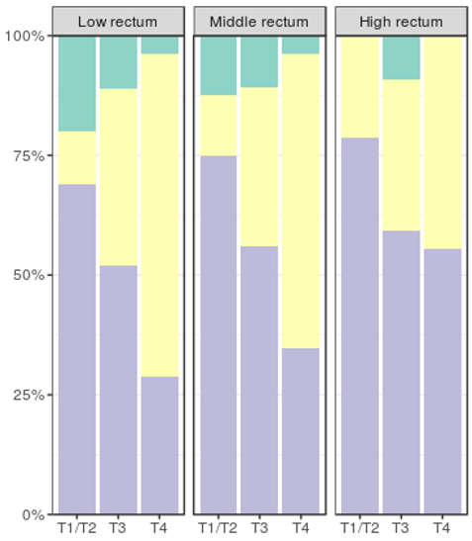
LCRT + pCR rates (n=2,572)
Question: In rectal cancer, what is the pathological complete response (pCR) rate following neoadjuvant long-course chemoradiotherapy (LCRT)?
Patients: Elective rectal resection.
Main outcome: pCR rate following LCRT.
Findings: A quarter of patients received LCRT, of whom 10.3% had pCR and 35.9% had a partial pathological response. Non-operative management of rectal cancer may be possible in selected patients with LCRT. There was limited agreement between post-LCRT radiological and pathological staging.
European Society of Coloproctology | www.escp.eu.com | @escp_tweets | @ESCP_studies | #ESCP2017audit
Notes:
Full details are available in the published Colorectal Disease special edition, available at: https://onlinelibrary.wiley.com/loi/14631318

Slide 14
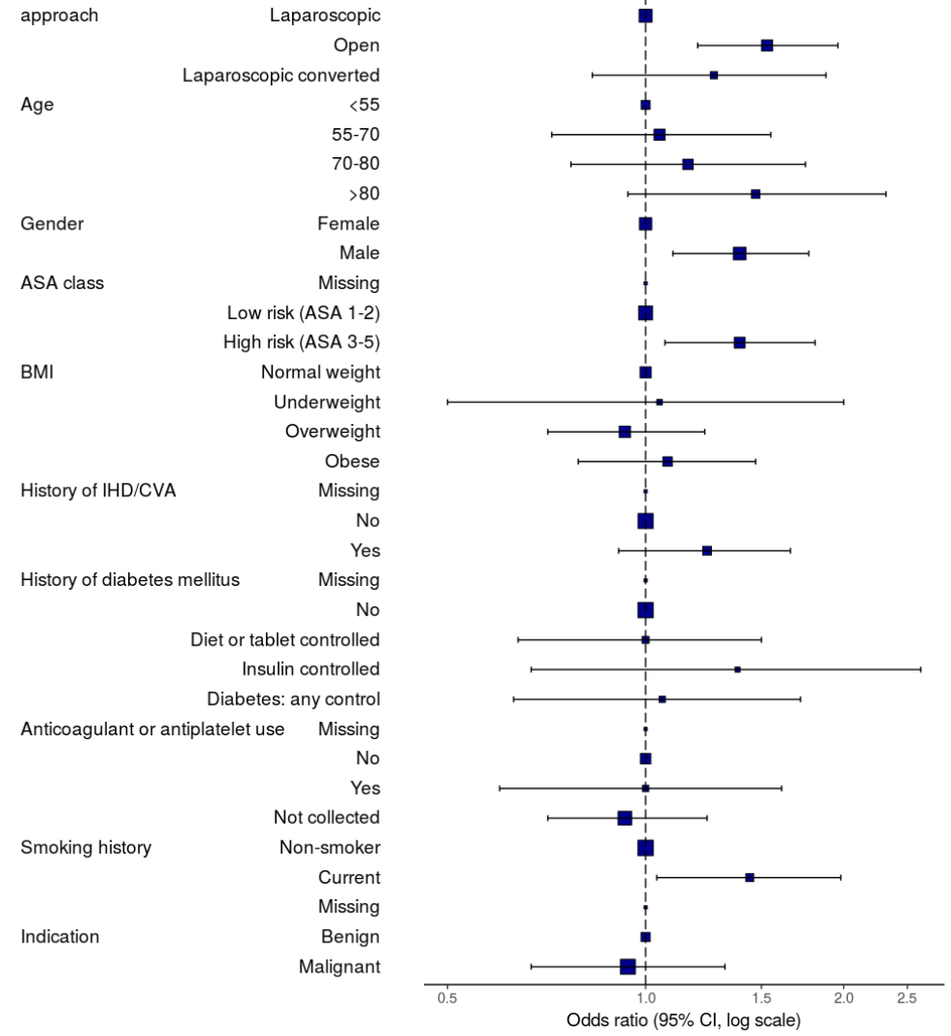
Laparoscopy (n=3,980)
Question: What is the safety profile of laparoscopic conversion?
Patients: Segmental colonic resection (pooled 2015 & 2017 ESCP audit).
Main outcome: 30-day Clavien-Dindo grade 3-5 complications.
Findings: Two thirds of cases were started laparoscopically, of which 15% were converted to open. Laparoscopic conversion did not place patients at increased risk of complications when compared to planned open surgery, suggesting surgeons select patients appropriately.
European Society of Coloproctology | www.escp.eu.com | @escp_tweets | @ESCP_studies | #ESCP2017audit
Notes:
Full details are available in the published Colorectal Disease special edition, available at: https://onlinelibrary.wiley.com/loi/14631318

Slide 15
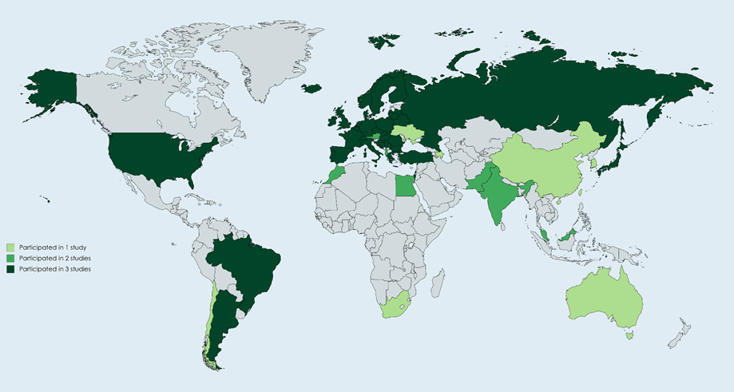
ESCP audits 2015-17
Join our mailing list to keep up to date with future studies:
https://is.gd/escp_reg
European Society of Coloproctology | www.escp.eu.com | @escp_tweets | @ESCP_studies | #ESCP2017audit
Notes:
Key points:
This map demonstrates the countries that have taken part in the ESCP Snapshot Studies to date
There are three new studies planned for 2018-20 spanning subtotal colectomy, parastomal herniation and robotic surgery.
Please do consider getting involved and share the study protocols with your friends and colleagues!
To help us keep track of local and national presentations, we would be very grateful if you please complete our brief feedback survey once you have presented the data/slides: https://bistc.redcap.bham.ac.uk/surveys/?s=CCPP74RTH8. We would be very interested in your feedback!

